Slide 1

ALL ABOUT
HARDWARE COMPONENTS
SUBMITTED TO:
PROF. MIKE ALESHAMS
SUBMITTED BY:
ASHOK KUMAR SAINI

Slide 2
CONTENTS
List of Hardware Components
Bills and status of the orders
Specifications
Reference

Slide 3
2 Beaglebone
Arduino UNO
GSM module (SIM 900)
Xbee S2C RF module (Rx and Tx)
20*4 LCD Module
4.3" cape LCD touch screen (Nextion)
Hardware components used in my project

Slide 4
Breadboard/Zero PCB
2 SD cards (32GB each)
Jumper wires
Power supply (Adapter)
Soldering Equipment (soldering iron, soldering wire)
Carbon Monoxide detection sensor
Hardware components used in my project

Slide 5
Temperature Sensor (LM 35)
Smoke and LPG gas sensor (MQ-2)
Mct2e optocoupler
Buzzer
Wire cutter
Wire stripper
Hardware components used in my project

Slide 6
12v DC Fan
Power supply
Hardware components used in my project

Slide 7
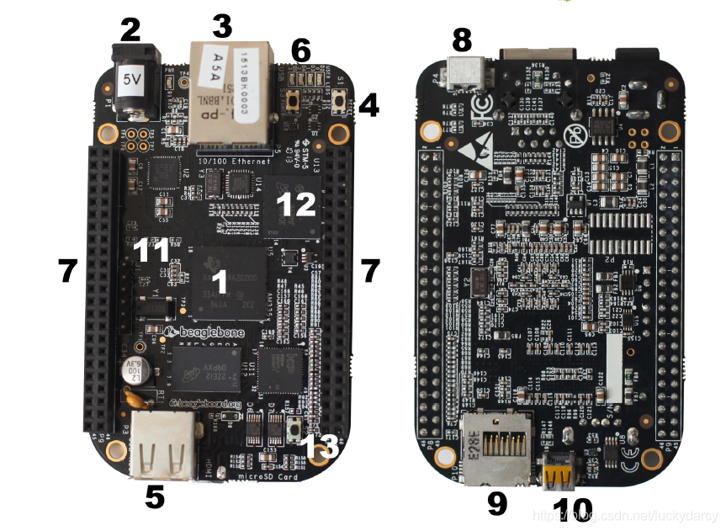
Beaglebone black
This Photo by Unknown Author is licensed under CC BY-SA

Slide 8
Specifications:
512MB DDR3 RAM
4GB 8-bit eMMC on-board flash storage
3D graphics accelerator
NEON floating-point accelerator
2x PRU 32-bit microcontrollers

Slide 9
USB client for power & communications
USB host
Ethernet
HDMI
2x 46 pin headers
Connectivity

Slide 10
Basically it is central MCU which is master controller, used to control all peripherals(sensors, XBee module, input and output screens).
Link for purchase:
https://www.digikey.ca/en/products/detail/ghi-electronics-llc/BBBWL-SC-562/6211000
Some other info of beaglebone:

Slide 11
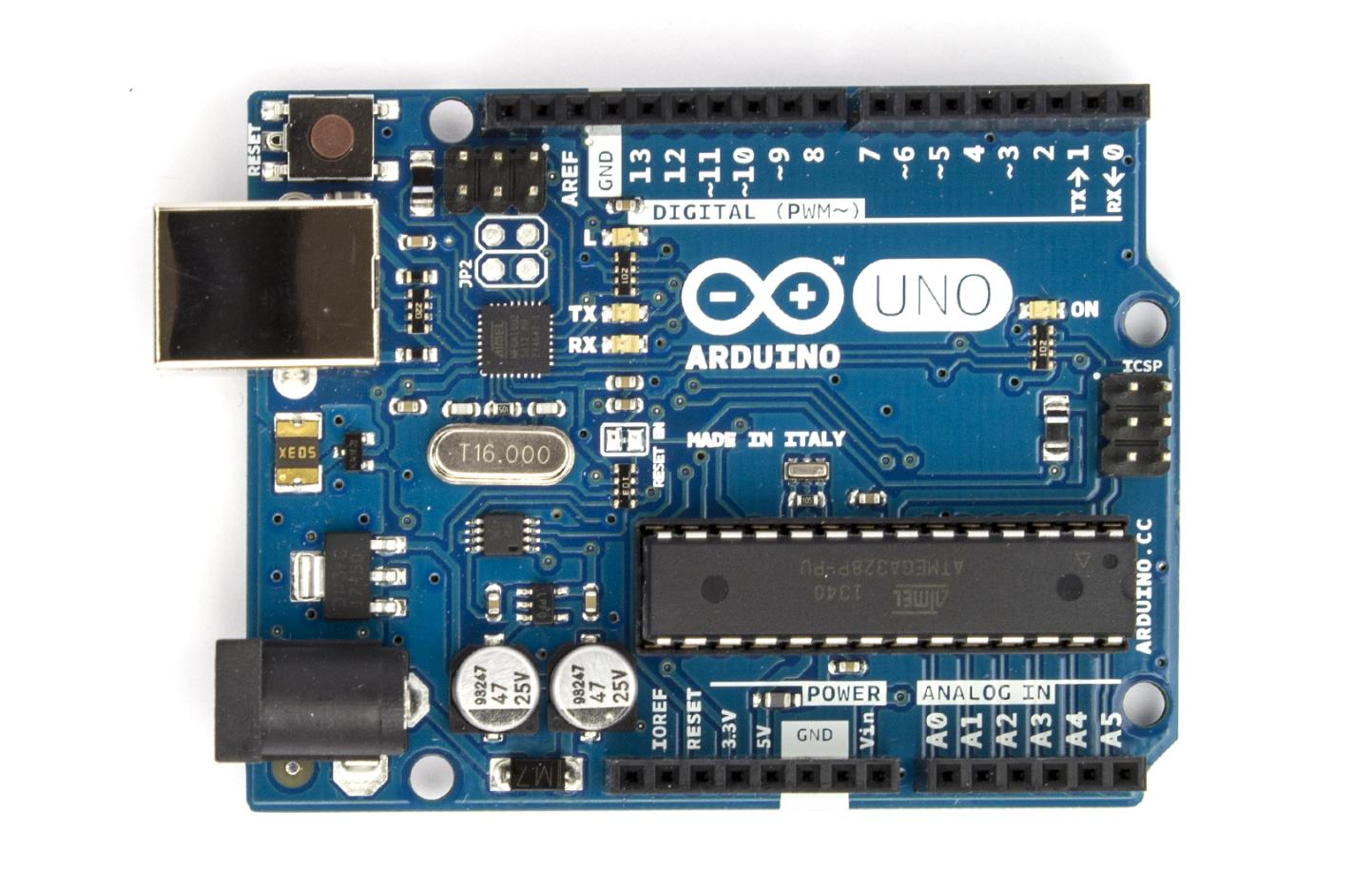
Arduino UNO
This Photo by Unknown Author is licensed under CC BY-NC

Slide 12
ATmega328 microcontroller
Input voltage - 7-12V
14 Digital I/O Pins (6 PWM outputs)
6 Analog Inputs
32k Flash Memory
16Mhz Clock Speed
Features:

Slide 13
Link for purchasing Arduino UNO
https://www.amazon.ca/Arduino-A000073-Uno-REV3-SMD/dp/B00PUOVSYS/ref=asc_df_B00PUOVSYS/?tag=googleshopc0c-20&linkCode=df0&hvadid=335186302991&hvpos=&hvnetw=g&hvrand=1307482696870636165&hvpone=&hvptwo=&hvqmt=&hvdev=c&hvdvcmdl=&hvlocint=&hvlocphy=1002216&hvtargid=pla-720685530711&psc=1

Slide 14
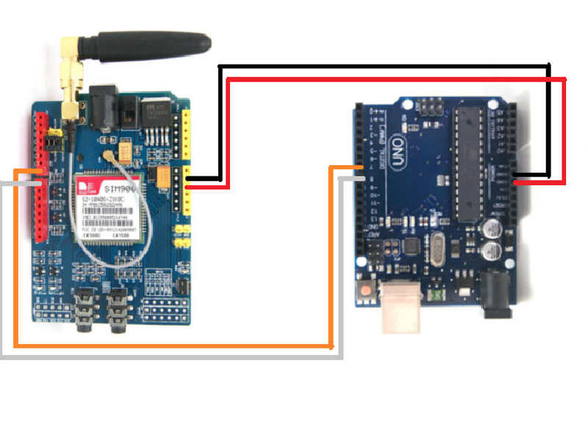
Gsm module
This Photo by Unknown Author is licensed under CC BY

Slide 15
Some features:
Embedded TCP/UDP stack - allows you to upload data to a web server. RTC supported. Selectable serial port. Speaker and Headphone jacks. Low power consumption - 1.5mA(sleep mode).
The TTL serial port is compatible with 3.3 and 5V microcontrollers.
This module is powered by: 5V-26V, 5V 2A power supply is recommended. After plugging in the motherboard, the power supply must be able to supply 2A.
Standard Commands: GSM 07.07 & 07.05 | Enhanced Commands: SIMCOM AT Commands. Short Message Service - so that you can send small amounts of data over the network (ASCII or raw hexadecimal).

Slide 16
Link for purchasing:
https://www.amazon.ca/Development-Board-Module-SIM900-Antenna/dp/B07XY79G56/ref=asc_df_B07XY79G56/?tag=googleshopc0c-20&linkCode=df0&hvadid=459365159187&hvpos=&hvnetw=g&hvrand=6076204753936425301&hvpone=&hvptwo=&hvqmt=&hvdev=c&hvdvcmdl=&hvlocint=&hvlocphy=1002216&hvtargid=pla-1118222255444&psc=1

Slide 17
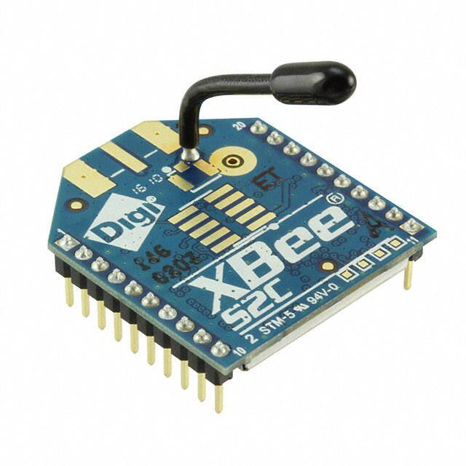
Xbee S2C RF module (Rx and Tx)

Slide 18
Transmission Frequency: 2.4GHz to 2.5GHz
Number of Channels: 16 Direct Sequence Channels
Featured with UART (250 Kb/s maximum) and SPI (5 Mb/s maximum) interface
Featured with software adjustable transmitting power
Indoor/Urban Range: 200ft
Features and Electrical Characteristics

Slide 19
Transmit Power Output: 6.3mW (8dBm) in Boost mode,2mW (3dBm) in Normal mode
RF Data Rate: 250,000 bps
Receiver Sensitivity: -102dBm in Boost mode, -100dBm in Normal mode
Supply Voltage Range: +2.1V to +3.6V

Slide 20
Link for purchase:
https://www.digikey.ca/en/products/detail/digi/XB24CAWIT-001/6010100

Slide 21
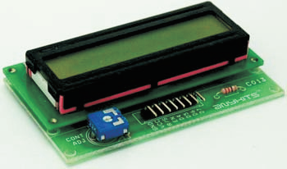
20*4 LCD Module
This Photo by Unknown Author is licensed under CC BY-SA

Slide 22
With this shield, you can display whatever you want by programming the for Arduino board.
(Easy to Use) Less I/O ports are occupied, only four - VCC, GND, SDA (serial data line), SCL (serial clock line). Address of the module: 0x27.
Features

Slide 23
(Support IIC Interface) It only takes two I/O port thus saving more for other usages.
(Widely Applications) LCD display module based on the popular HD44780 controller, works great with for Arduino / Uno R3 / Mega2560 board and other micro-controllers.
Features

Slide 24
Link for purchase
https://www.amazon.ca/WayinTop-Display-Interface-Adapter-Arduino/dp/B07TXGD3WS/ref=sr_1_2?dchild=1&keywords=lcd+16+x+4&qid=1613091271&sr=8-2

Slide 25
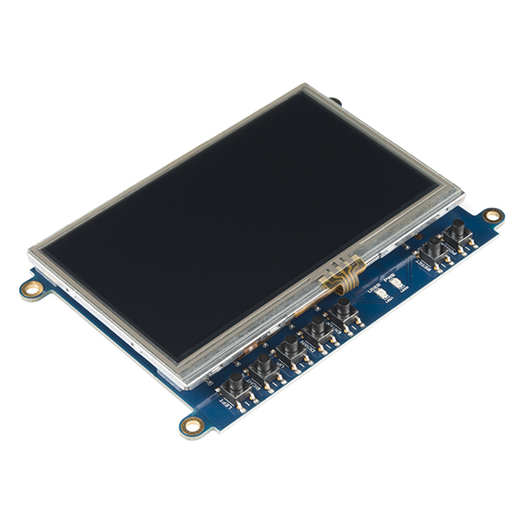
4.3" cape LCD touch screen (Nextion)
This Photo by Unknown Author is licensed under CC BY-ND

Slide 26
NX4827T043 is nextion 4.3 basic screen: 4.3 inch TFT, 480x272 resistive touch display, 16M flash, 2K Byte RAM, 65k colors.
Uploading TFT file via sd card is faster than 4pin serial port, but pls check card format is FAT32 and no more than 32GB.
Features

Slide 27
Link for purchase
https://www.amazon.ca/Nextion-NX4827T043-Intelligent-Display-Module/dp/B07B9XTSWH/ref=asc_df_B07B9XTSWH/?tag=googleshopc0c-20&linkCode=df0&hvadid=459365159187&hvpos=&hvnetw=g&hvrand=9840892710536151605&hvpone=&hvptwo=&hvqmt=&hvdev=c&hvdvcmdl=&hvlocint=&hvlocphy=1002216&hvtargid=pla-1046109602772&psc=1

Slide 28
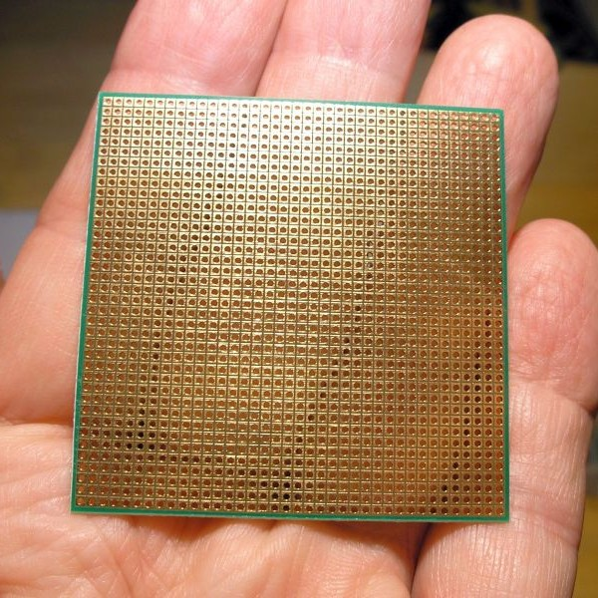
Zero PCB
This Photo by Unknown Author is licensed under CC BY-SA-NC

Slide 29
It is basically a general-purpose printed circuit board (PCB), also known as perfboard or DOT PCB. It is a thin rigid copper sheet with holes pre-drilled at standard intervals across a grid with 2.54mm (0.1-inch) spacing between holes. Each hole is encircled by a round or square copper pad so that component lead can be inserted into the hole and soldered around the pad without short-circuiting the nearby pads and other leads. For connecting the lead of component with another lead, solder these together or join these using a suitable conducting wire.
Link for purchase
https://www.amazon.ca/YUNGUI-Solder-able-Breadboard-Electronic-Experiment/dp/B07TTD5V2W/ref=asc_df_B07TTD5V2W/?tag=googlemobshop-20&linkCode=df0&hvadid=337093155729&hvpos=&hvnetw=g&hvrand=8071089510736342243&hvpone=&hvptwo=&hvqmt=&hvdev=m&hvdvcmdl=&hvlocint=&hvlocphy=9000993&hvtargid=pla-887992711367&psc=1

Slide 30
Rows and columns are labeled (a-z & 1-48) for easy operation.Though hole PCB boards with 1440( 48*30) tie points.
The material is all FR4 full glass fiber plate, which can effectively prevent the pad from falling off.
Features

Slide 31
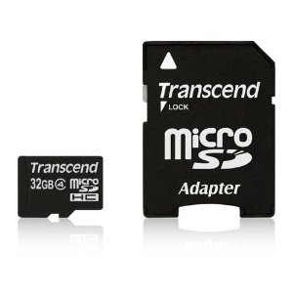
SD cards
This Photo by Unknown Author is licensed under CC BY-NC-ND

Slide 32
Main function is to flash latest debian image to BBB.
Transfer read speeds of up to 98MB/s.
Shockproof, temperature-proof, waterproof, and X-ray-proof
Features

Slide 33
Link for purchase:
https://www.amazon.ca/Sandisk-SDSQUAR-032G-GN6MA-Ultra-Micro-Adapter/dp/B073JWXGNT/ref=sr_1_2?dchild=1&gclid=Cj0KCQiAyJOBBhDCARIsAJG2h5ekEOqPM28E52wKiASjfFWghLKETkXNc936piG6Y6C4fIk6n1F326kaAhqEEALw_wcB&hvadid=208333453601&hvdev=c&hvlocphy=1002216&hvnetw=g&hvqmt=e&hvrand=5847459980430108279&hvtargid=kwd-300624131003&hydadcr=1280_10142922&keywords=sd+card+32gb&qid=1613094646&sr=8-2&tag=googcana-20

Slide 34
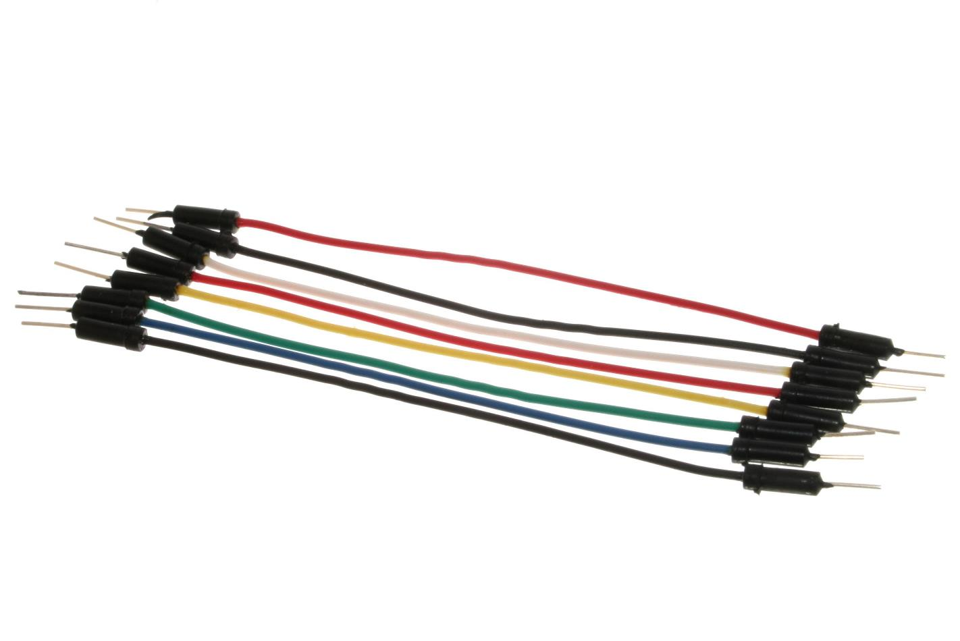
Jumper wires
This Photo by Unknown Author is licensed under CC BY-SA

Slide 35
Link for purchase:
https://www.amazon.ca/Elegoo-120pcs-Multicolored-Breadboard-arduino/dp/B01EV70C78/ref=asc_df_B01EV70C78/?tag=googleshopc0c-20&linkCode=df0&hvadid=292982668700&hvpos=&hvnetw=g&hvrand=3865135314936126261&hvpone=&hvptwo=&hvqmt=&hvdev=c&hvdvcmdl=&hvlocint=&hvlocphy=1002216&hvtargid=pla-362913641420&psc=1
For connecting components through breadboard.

Slide 36
Each cable length: about 20 cm /8-inch.
The cables can be separated to form an assembly containing the number of wires you require for your connection and to support non-standard odd-spaced headers.
Features

Slide 37
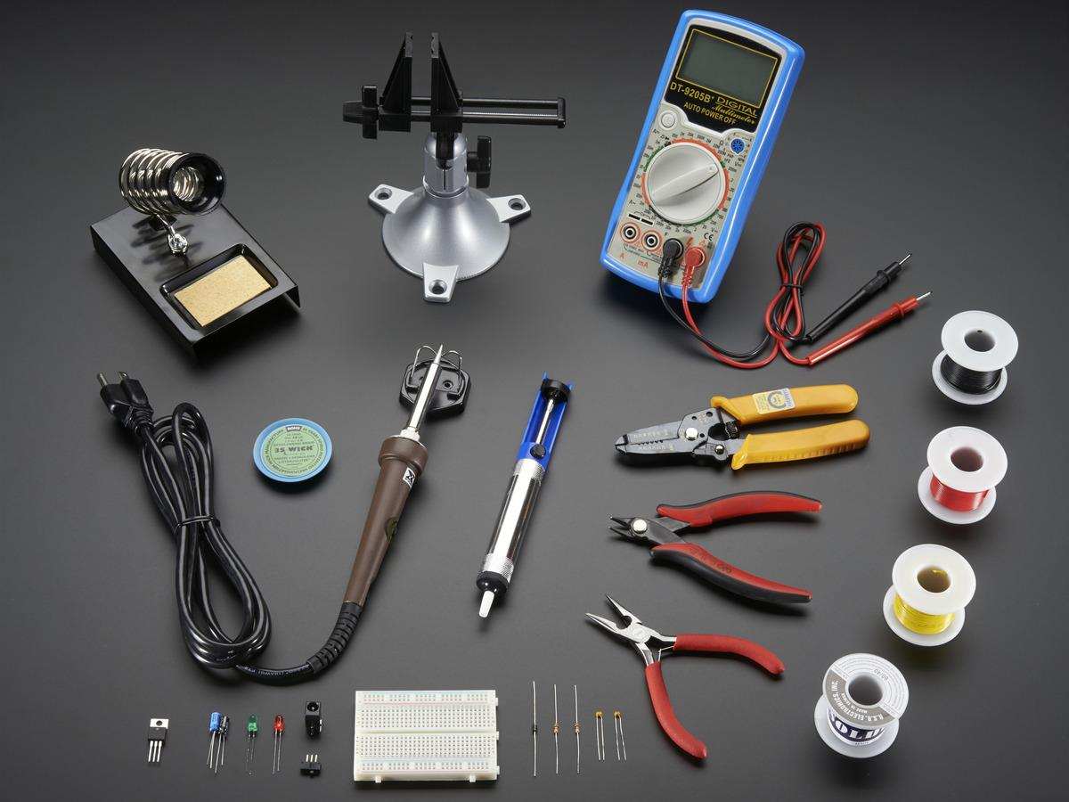
Soldering Equipment
This Photo by Unknown Author is licensed under CC BY-SA-NC

Slide 38
30W adjustable temperature Soldering iron (Model XY258) - with a temperature control on the side and indicator LED so you can go from standard to lead-free to silver solder.
Digital Multimeter - Model 9205B+ is a good-all-around basic multimeter. Has a continuity tester, DC/AC voltage and current, resistance, transistor and diode/LED test. Runs on a 9V battery.
Wire strippers- We've upgraded our basic 'adjustable' wire strippers to these multi-sized wire strippers. They include: 22-30 AWG strippers, wire cutters, 'plier' tips, and a wire loop.
Solder sucker - Strangely enough, that's the technical term for this desoldering vacuum tool.
Micro needle-nose pliers - for bending, forming, holding, squeezing and plying all of those little components.
Diagonal cutters - the best diagonal cutters, these are comfortable to use and have strong nippers for perfect trimming of wires and leads.
Solderless breadboard.

Slide 39
Link for purchase:
https://elmwoodelectronics.ca/products/ladyadas-electronics-toolkit

Slide 40
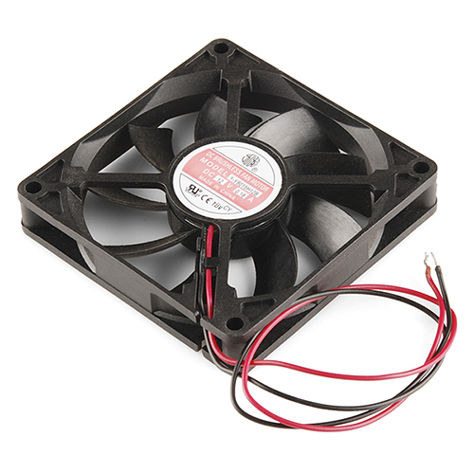
12v DC Fan
This Photo by Unknown Author is licensed under CC BY-SA

Slide 41
Operating Voltage Range：5.5V to 13.8V.
Rated Voltage: DC 12V; Rated Current: 0.18mp; Rated Speed: 2800RPM; Air flow: 32.8CFM; Noise: 28dBA
Bearing Type: Sleeve Bearing ; Life: working up to 35000h at 25 degrees.
Features

Slide 42
Link for purchase
https://www.amazon.ca/GDSTIME-80mm-15mm-Brushless-Cooling/dp/B081YST8ZL/ref=sr_1_7?dchild=1&gclid=Cj0KCQiAyJOBBhDCARIsAJG2h5eSbujTwmMLv_2k0yFyDyyaXw1-04j9O9MQwH1IsQZk2EriwJqHtXwaAq93EALw_wcB&hvadid=208324174456&hvdev=c&hvlocphy=1002216&hvnetw=g&hvqmt=e&hvrand=15886458366241368862&hvtargid=kwd-306113092745&hydadcr=617_9459495&keywords=12v+dc+fan&qid=1613097871&sr=8-7&tag=googcana-20

Slide 43
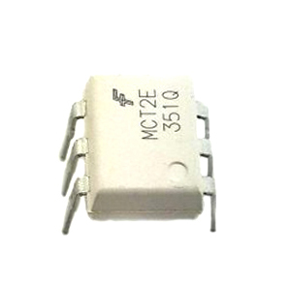
Opto-coupler

Slide 44
This device allows to transmit an electrical signal between two isolated circuits .
Link for purchase
https://www.digikey.ca/en/products/detail/on-semiconductor/MCT2EM/400424

Slide 45
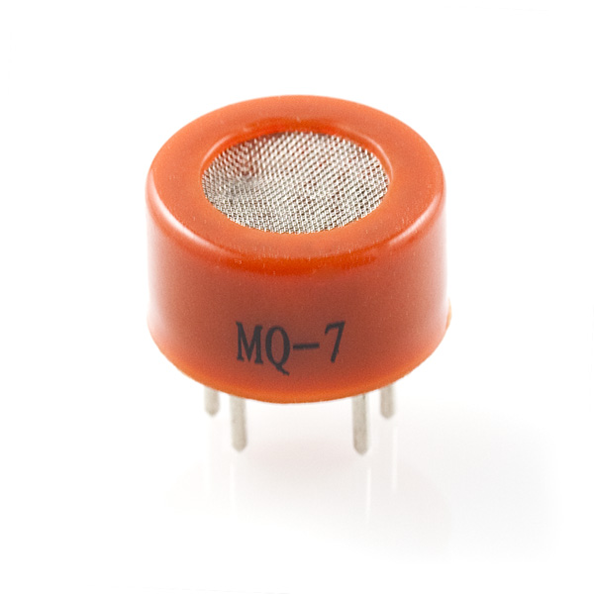
Carbon Monoxide detection sensor
This Photo by Unknown Author is licensed under CC BY-SA

Slide 46
For home or factory gas leakage monitoring devices, suitable for carbon monoxide and other combustible gases.
Specifications: Product Model: MQ-9 - ProductType: Se-miconduct gas sensitive element , Gas Detected: Carbon monoxide, Combustible gas , Detectable Concentration: 10-1000 ppmCO, 100-10000 PPM gas.
Features

Slide 47
Link for purchase
https://www.amazon.com/MQ-Carbon-Monoxide-Combustible-Sensor/dp/B01N2MW3X5

Slide 48
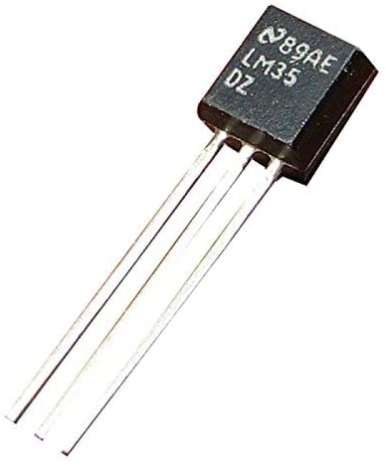
Temperature Sensor

Slide 49
It is used to measure if temperature is above any given range or not.
Link for purchase:
https://www.digikey.ca/en/products/detail/texas-instruments/LM35DZ-NOPB/32489

Slide 50
Minimum and Maximum Input Voltage is 35V and -2V respectively. Typically 5V.
Can measure temperature ranging from -55°C to 150°C.
±0.5°C Accuracy Drain current is less than 60uA.
Features

Slide 51
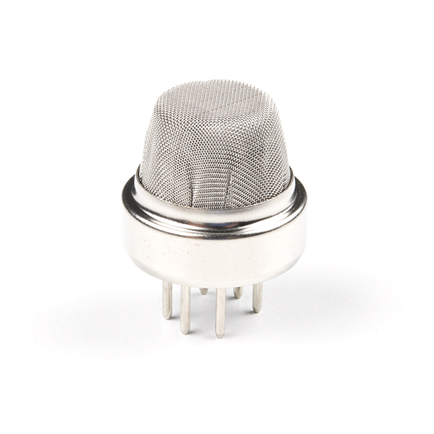
Smoke sensor

Slide 52
It can detect flammable gas in a range of 300 - 10000ppm.
It's most common use is domestic gas leakage alarms and detectors with a high sensitivity to propane and smoke.
Link
https://www.sparkfun.com/products/17049
Features

Slide 53
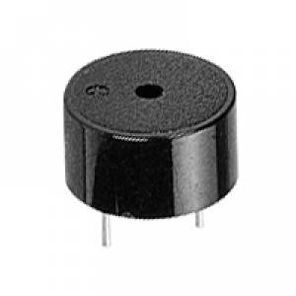
buzzer
This Photo by Unknown Author is licensed under CC BY-SA-NC

Slide 54
Magnetic 5V Panel Mount, Flange PC Pins.
It is used to alert kitchen staff about new order.
Link
https://www.digikey.ca/en/products/detail/tdk-corporation/SD1614T5-B5ME/8017772
Features

Slide 55
Power supply
Power adapter for beaglebone:
5v and 2 amp
2) Battery for fan:
9v

Slide 56
References:
Beaglebone black:
https://beagleboard.org/black
2) Arduino UNO:
https://www.amazon.ca/Arduino-A000073-Uno-REV3-SMD/dp/B00PUOVSYS/ref=asc_df_B00PUOVSYS/?tag=googleshopc0c-20&linkCode=df0&hvadid=335186302991&hvpos=&hvnetw=g&hvrand=1307482696870636165&hvpone=&hvptwo=&hvqmt=&hvdev=c&hvdvcmdl=&hvlocint=&hvlocphy=1002216&hvtargid=pla-720685530711&psc=1
3) Gsm module:
https://www.amazon.ca/Development-Board-Module-SIM900-Antenna/dp/B07XY79G56/ref=asc_df_B07XY79G56/?tag=googleshopc0c-20&linkCode=df0&hvadid=459365159187&hvpos=&hvnetw=g&hvrand=6076204753936425301&hvpone=&hvptwo=&hvqmt=&hvdev=c&hvdvcmdl=&hvlocint=&hvlocphy=1002216&hvtargid=pla-1118222255444&psc=1

Slide 57
References:
4) Xbee S2C RF module (Rx and Tx):
https://www.digikey.ca/en/products/detail/digi/XB24CAWIT-001/6010100
5) 20*4 LCD Module:
https://www.amazon.ca/WayinTop-Display-Interface-Adapter-Arduino/dp/B07TXGD3WS/ref=sr_1_2?dchild=1&keywords=lcd+16+x+4&qid=1613091271&sr=8-2
6) 4.3" cape LCD touch screen (Nextion):
https://www.amazon.ca/Nextion-NX4827T043-Intelligent-Display-Module/dp/B07B9XTSWH/ref=asc_df_B07B9XTSWH/?tag=googleshopc0c-20&linkCode=df0&hvadid=459365159187&hvpos=&hvnetw=g&hvrand=9840892710536151605&hvpone=&hvptwo=&hvqmt=&hvdev=c&hvdvcmdl=&hvlocint=&hvlocphy=1002216&hvtargid=pla-1046109602772&psc=1

Slide 58
References:
7) Zero PCB:
https://www.amazon.ca/YUNGUI-Solder-able-Breadboard-Electronic-Experiment/dp/B07TTD5V2W/ref=asc_df_B07TTD5V2W/?tag=googlemobshop-20&linkCode=df0&hvadid=337093155729&hvpos=&hvnetw=g&hvrand=8071089510736342243&hvpone=&hvptwo=&hvqmt=&hvdev=m&hvdvcmdl=&hvlocint=&hvlocphy=9000993&hvtargid=pla-887992711367&psc=1
8) Sd cards:
https://www.amazon.ca/Sandisk-SDSQUAR-032G-GN6MA-Ultra-Micro-Adapter/dp/B073JWXGNT/ref=sr_1_2?dchild=1&gclid=Cj0KCQiAyJOBBhDCARIsAJG2h5ekEOqPM28E52wKiASjfFWghLKETkXNc936piG6Y6C4fIk6n1F326kaAhqEEALw_wcB&hvadid=208333453601&hvdev=c&hvlocphy=1002216&hvnetw=g&hvqmt=e&hvrand=5847459980430108279&hvtargid=kwd-300624131003&hydadcr=1280_10142922&keywords=sd+card+32gb&qid=1613094646&sr=8-2&tag=googcana-20

Slide 59
References:
8) Jumper wires:
https://www.amazon.ca/Elegoo-120pcs-Multicolored-Breadboard-arduino/dp/B01EV70C78/ref=asc_df_B01EV70C78/?tag=googleshopc0c-20&linkCode=df0&hvadid=292982668700&hvpos=&hvnetw=g&hvrand=3865135314936126261&hvpone=&hvptwo=&hvqmt=&hvdev=c&hvdvcmdl=&hvlocint=&hvlocphy=1002216&hvtargid=pla-362913641420&psc=1
8) Solder kit:
https://elmwoodelectronics.ca/products/ladyadas-electronics-toolkit
9) fan:
https://www.amazon.ca/GDSTIME-80mm-15mm-Brushless-Cooling/dp/B081YST8ZL/ref=sr_1_7?dchild=1&gclid=Cj0KCQiAyJOBBhDCARIsAJG2h5eSbujTwmMLv_2k0yFyDyyaXw1-04j9O9MQwH1IsQZk2EriwJqHtXwaAq93EALw_wcB&hvadid=208324174456&hvdev=c&hvlocphy=1002216&hvnetw=g&hvqmt=e&hvrand=15886458366241368862&hvtargid=kwd-306113092745&hydadcr=617_9459495&keywords=12v+dc+fan&qid=1613097871&sr=8-7&tag=googcana-20

Slide 60
References:
10) optocoupler:
https://www.digikey.ca/en/products/detail/on-semiconductor/MCT2EM/400424
11) Smoke sensor:
https://www.sparkfun.com/products/17049
12) Temperature sensor:
https://www.digikey.ca/en/products/detail/texas-instruments/LM35DZ-NOPB/32489
13) buzzer:
https://www.digikey.ca/en/products/detail/tdk-corporation/SD1614T5-B5ME/8017772

Slide 61
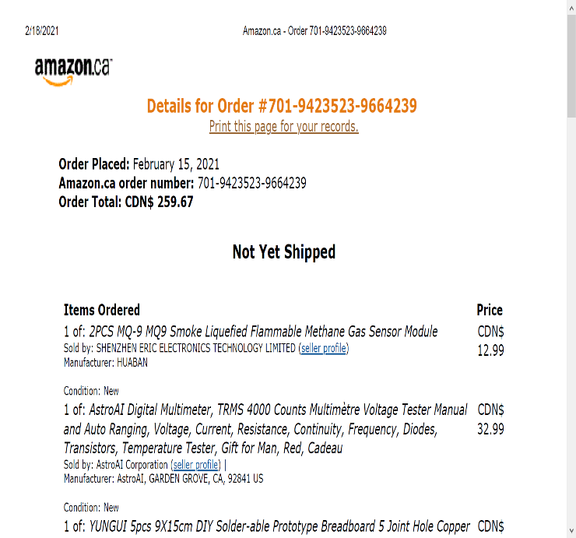
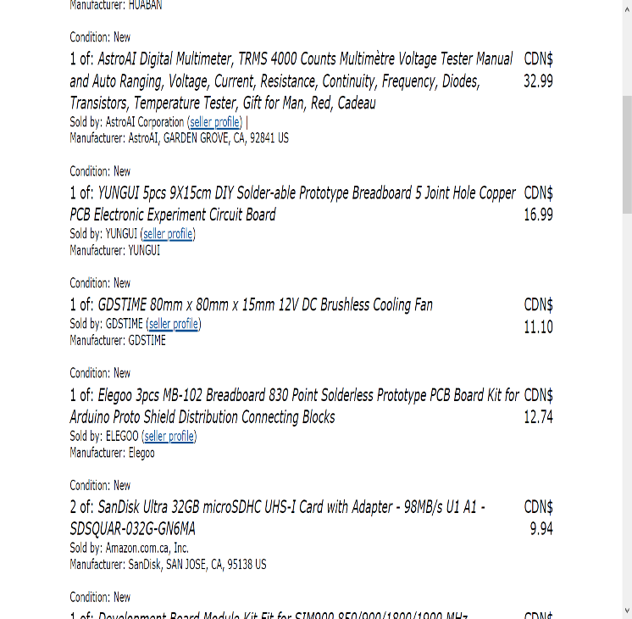
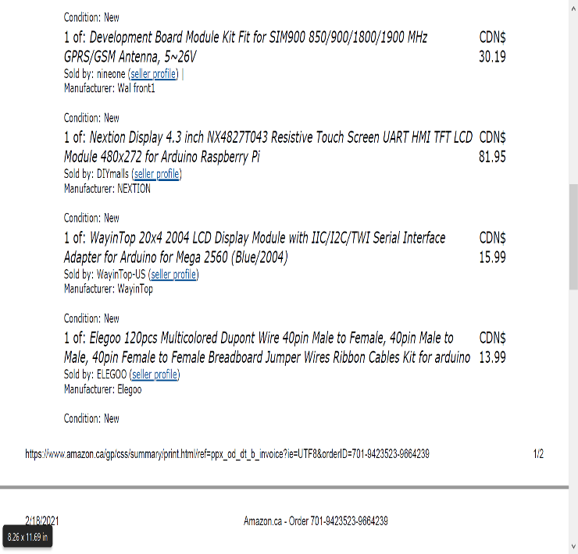
Invoice:

Slide 62
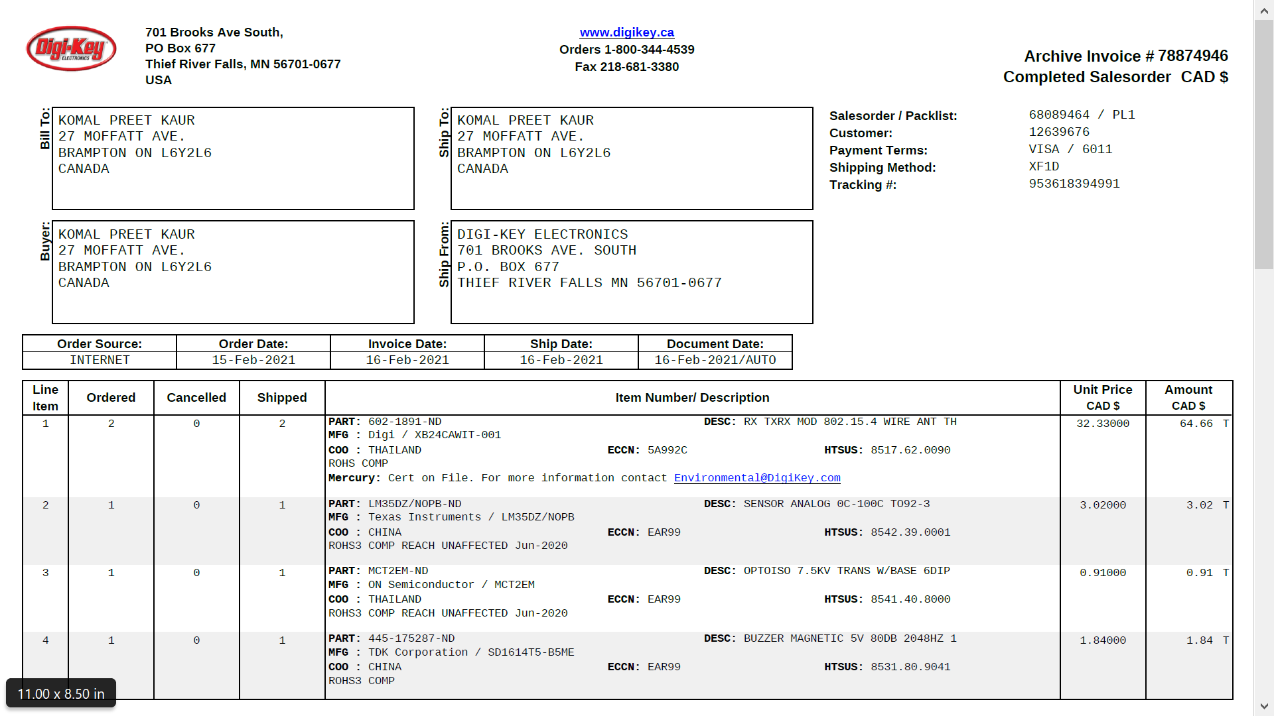
Invoice:

Slide 63
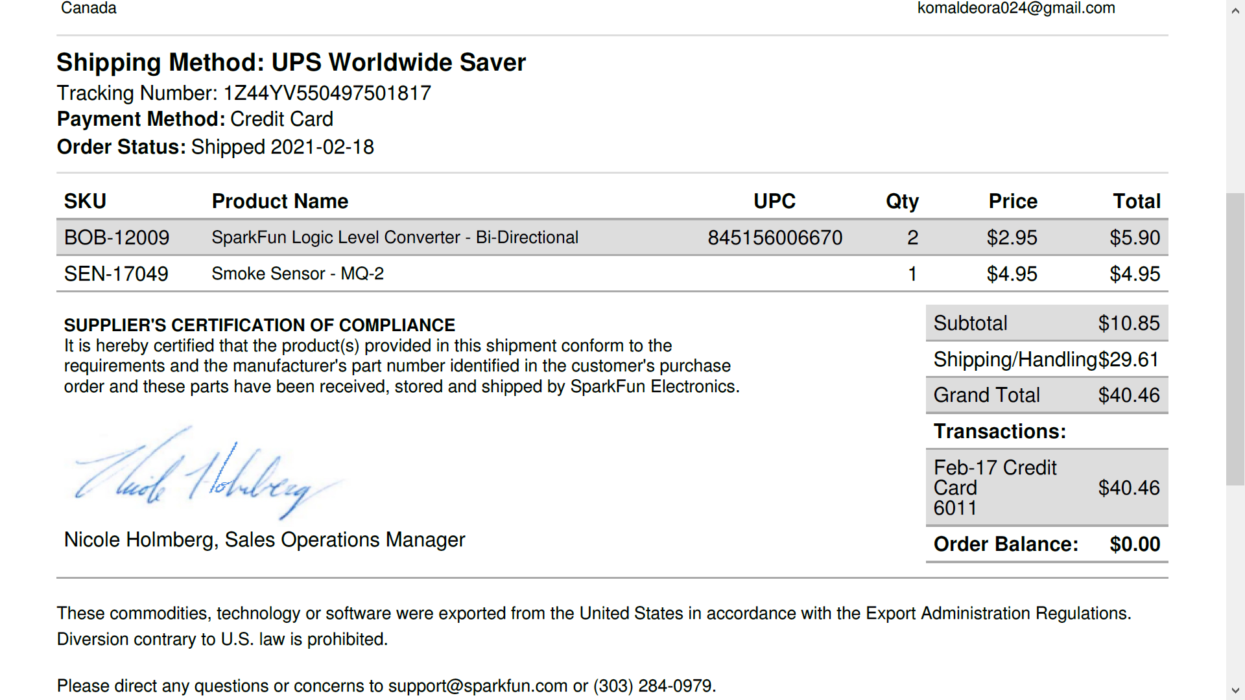
Invoice:

